Slide 1
UV-C Seed disinfection
Naiopur from Dinies Technologies

Slide 2
UV-C disinfection
Naiopur
Naiopur was designed specifically for efficient and cost-effective disinfection of seeds, grains, herbs, spices, etc.
A disinfection rate of 99.9% was confirmed by reputable German laboratories
Main focus during the development was a robust construction with an easy handling process and high production efficiency

Slide 3
Area of application

Slide 4
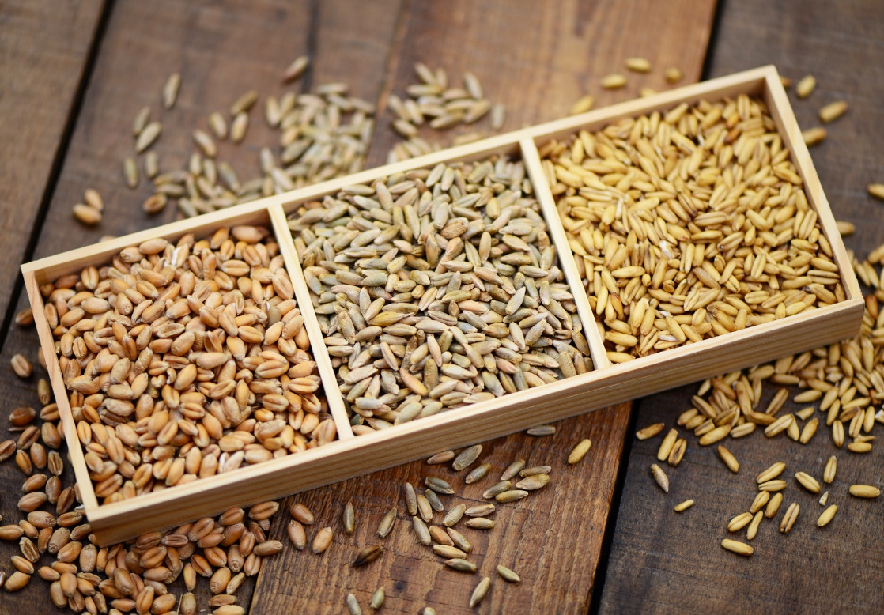
Area of application
General information
Naiopur UV-C disinfector is very flexible in its applicability
It is mostly used by the food and agriculture industry
It can be used for almost all dry products
If your product is not listed below, please contact us and we are happy to discuss specific disinfection options

Slide 5
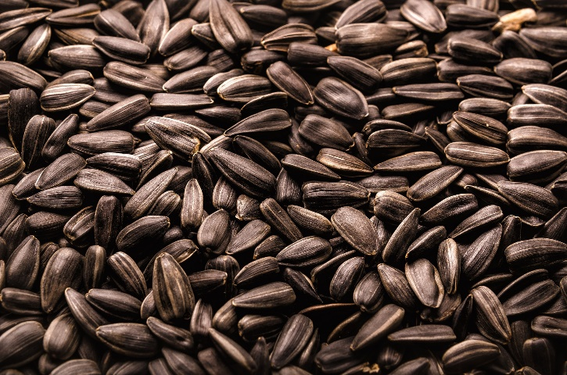
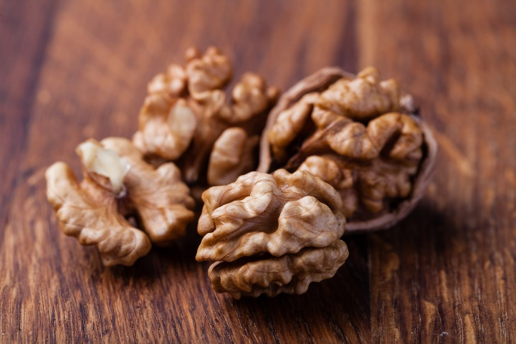
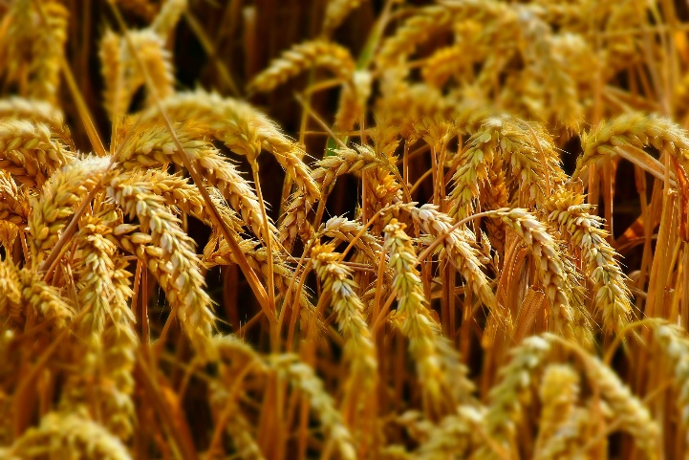
Area of application
Naiopur UV-C disinfection
Seeds
Pumpkin seeds
Sunflower seeds
Hemp seeds
Sesame seeds
…
Nuts
Walnut
Hazelnut
Cashew nuts
Peanuts
…
Grain
Wheat
Rye
Barley
Oat
…

Slide 6
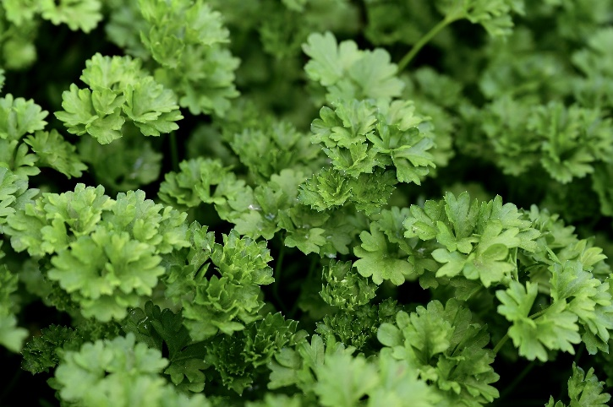
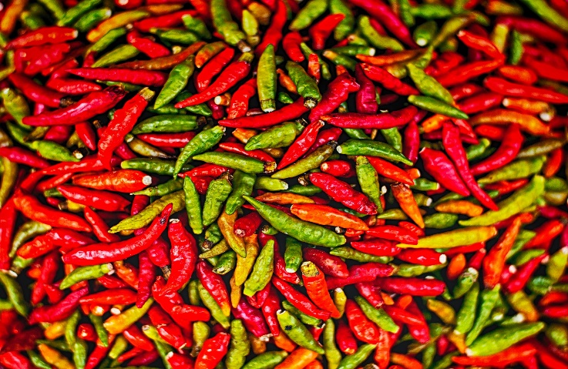
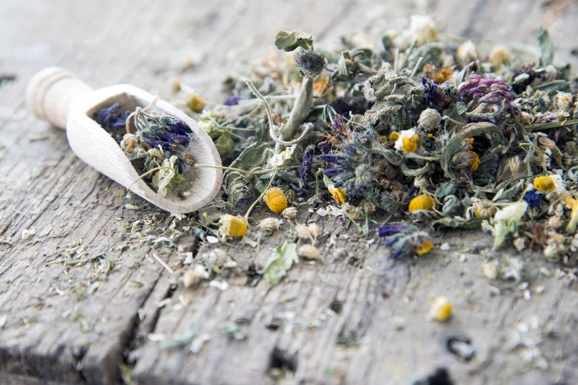
Area of application
Naiopur UV-C disinfection
Herbs
Oregano
Parsley
Rosemary
Thyme
…
Spices
Chili
Cinnamon
Pepper
Cloves
…
Tea
Dried tea leaves
Green tea
Black tea
Oolong
…

Slide 7
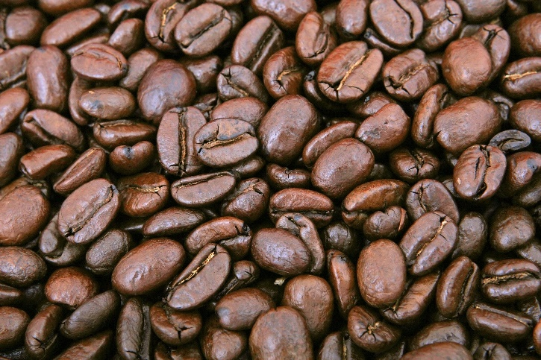
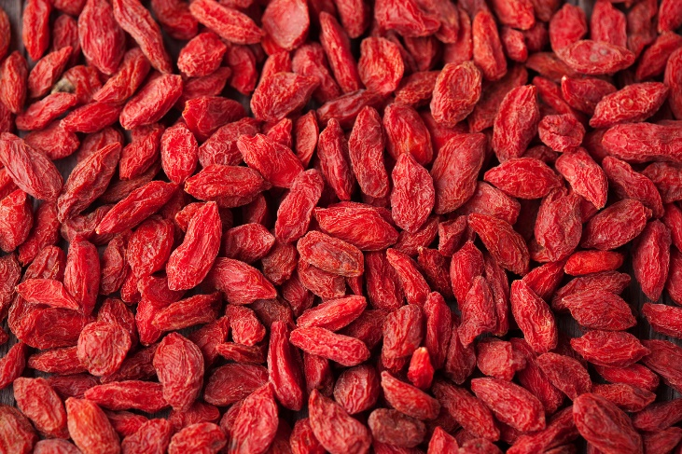
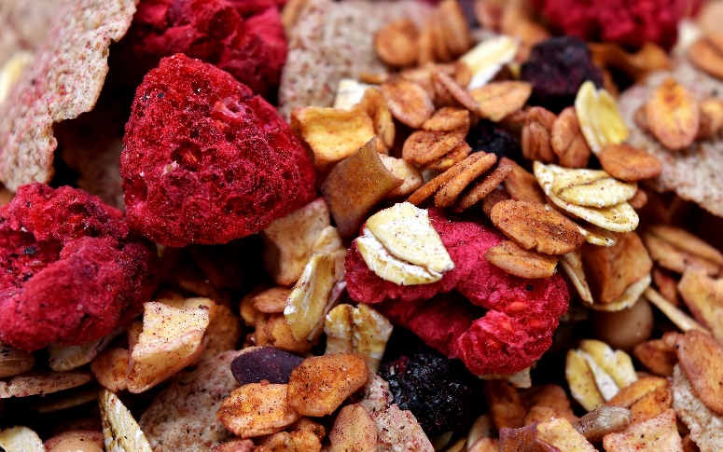
Area of application
Naiopur UV-C disinfection
Beans
Kidney beans
Soybeans
Coffee beans
Chickpeas
…
Dried fruits
Cranberry
Apricots
Figs
Goji berries
…
And much more
Products for natural cosmetics
Raw products for muesli and muesli bars
…

Slide 8
UV-C light

Slide 9
What is UV light?
How does it work?
UV light is invisible to the human eye, but it can be used to eliminate microorganisms
UV-light
Humanly visible spectrum
UV-C
UV-B
UV-A
X-rays
Infrared
100
185
254
280
315
380
400
750
nm
germ-killing wavelength
ozone-generating wavelength

Slide 10
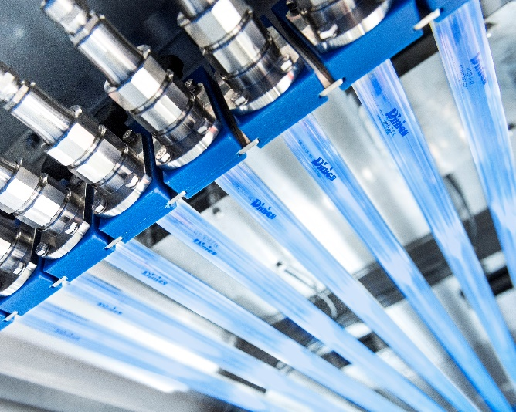
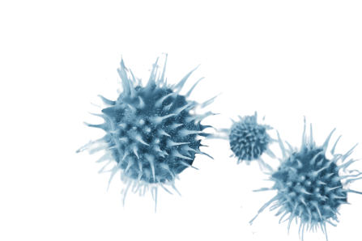
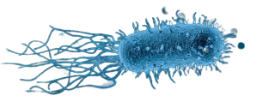
4 Factors for UV-C disinfection
What is important?
1.
2.
3.
4.
Microorganisms
Distance
UV-C power
Time

Slide 11
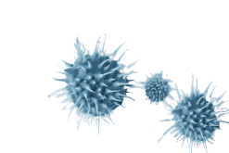
Important radiation doses
Lethal doses to kill microorganisms
1.
2.
3.
4.
Microorganism | Distance | Radiation dose* | Time
Bacteria
Escherichia coli | 5 cm | 9 mWs/cm² | 0,74 sec
Legionella pneumophila | 5 cm | 2,8 mWs/cm² | 0,23 sec
Mycobacterium tuberculosis | 5 cm | 30 mWs/cm² | 2,46 sec
Viruses
Influenza virus | 5 cm | 10,2 mWs/cm² | 0,84 sec
SARS-CoV-2 | 5 cm | 10,6 mWs/cm² | 0,80 sec
Mold spores
Aspergillus niger | 5 cm | 396 mWs/cm² | 32,46 sec
*radiation dose necessary for 90% disinfection / log 1

Slide 12
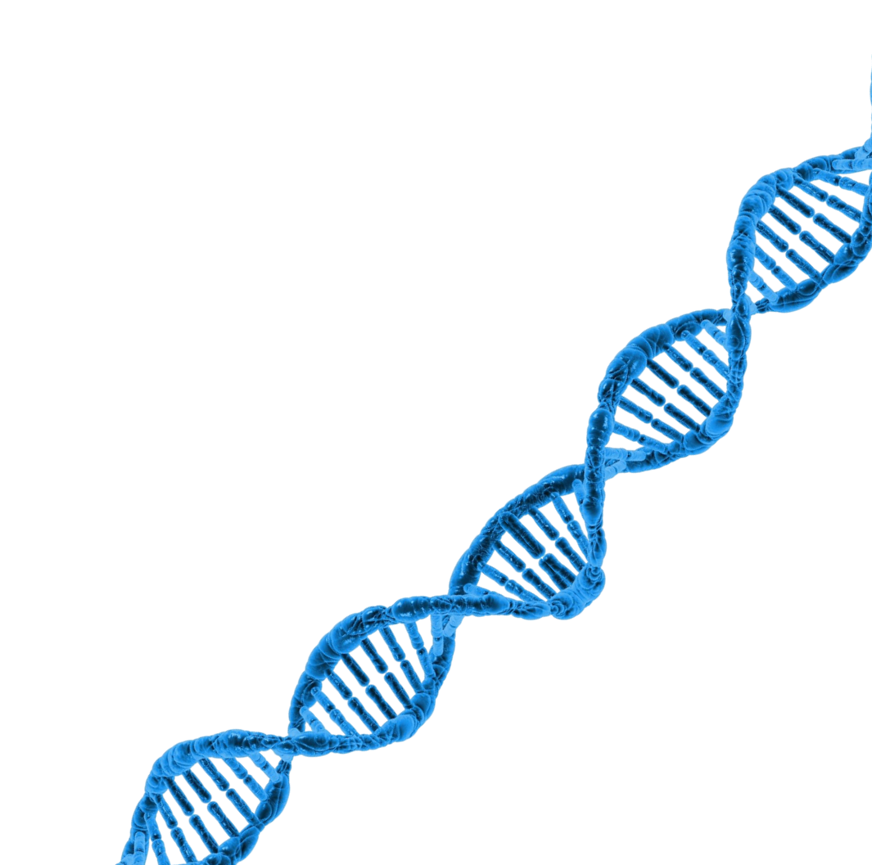
UV-C disinfection
What is happening?
The UV-C irradiation with 254nm wavelength is modifying the DNA of a microorganism to stop the reproduction
When a virus or bacteria is unable to multiply it is considered dead and can no longer be infectious
Very short deactivation time
Development of a resistance is impossible

Slide 13
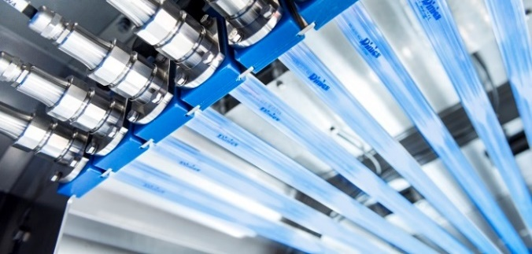
UV-C light
Summary
Disinfection up to 99.9%
Elimination of all microorganisms
Very effective and quick disinfection method
Low maintenance and inexpensive
Chemical free

Slide 14
Disinfection process

Slide 15
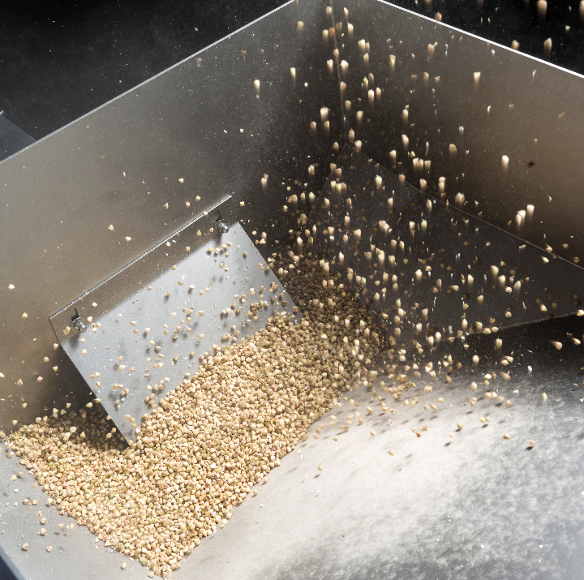
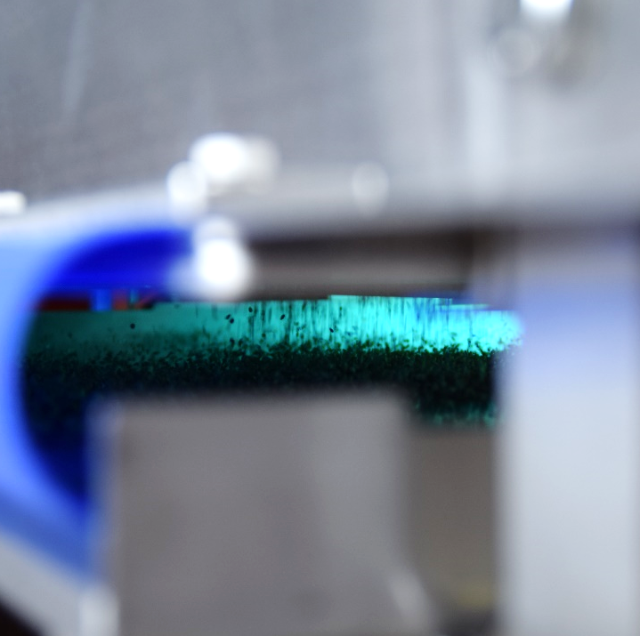
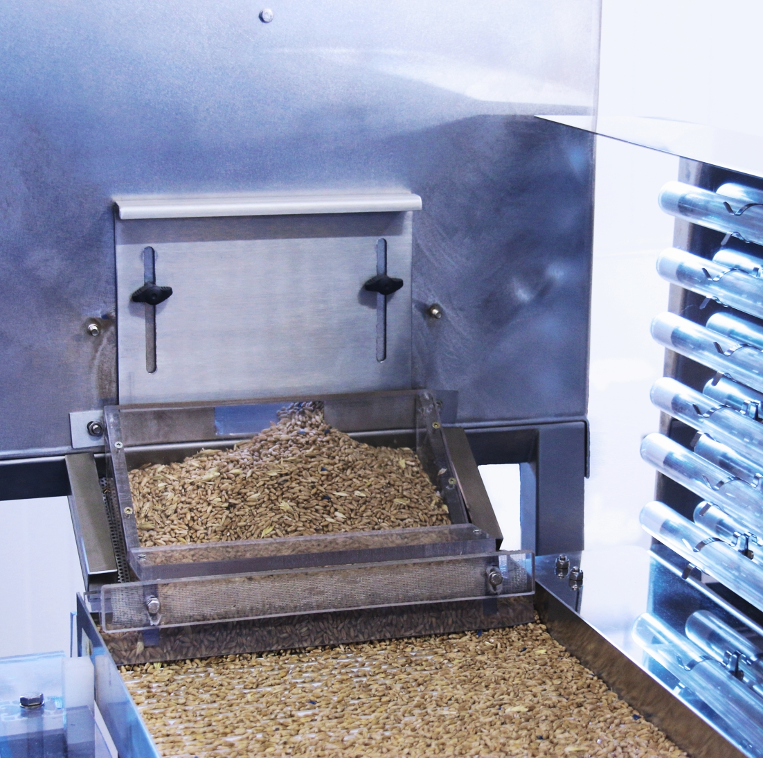
UV-C disinfection process
How does it work?
Product is filled directly into the feed hopper
The input control regulates how much seeds are getting through
The replaceable filter will keep out unwanted dirt and soil

Slide 16
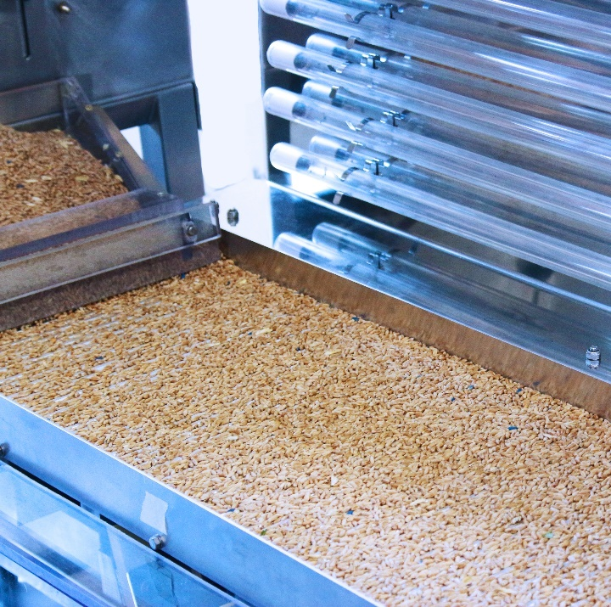
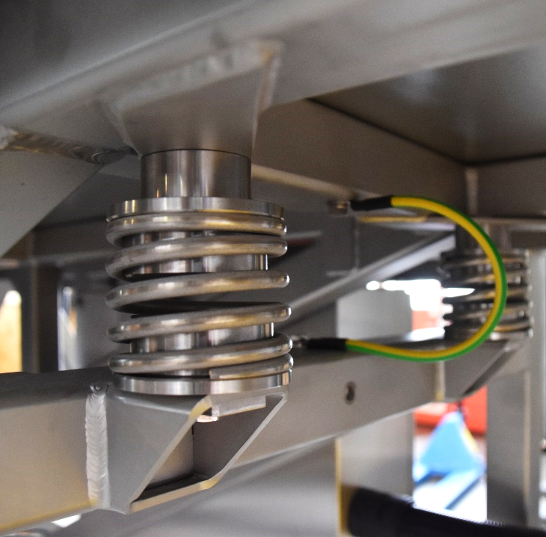
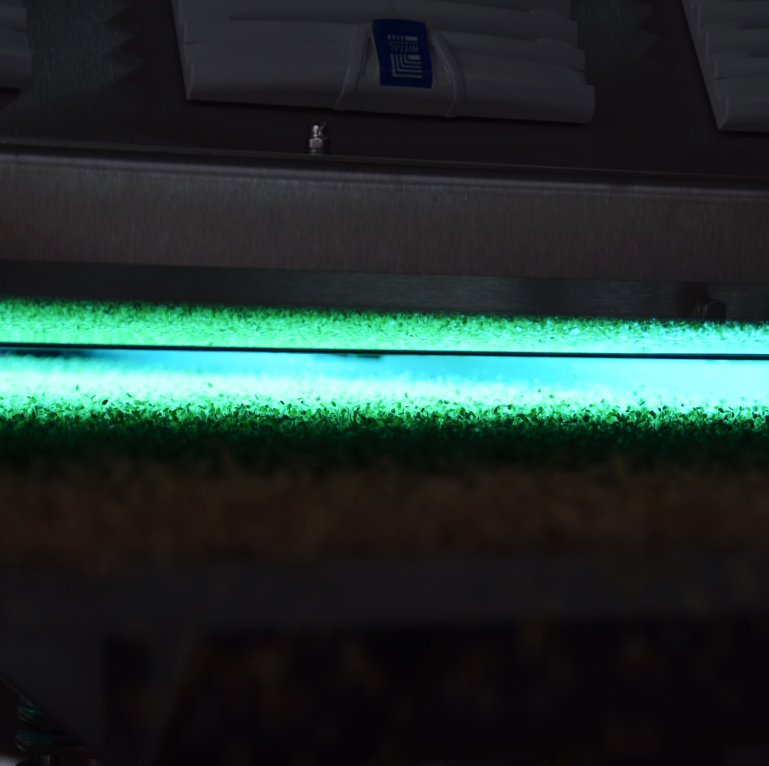
UV-C disinfection process
How does it work?
The seeds are distributed evenly onto the transport plate
And then transported through a vibration technique
The seeds are passing underneath the UV-C lights

Slide 17
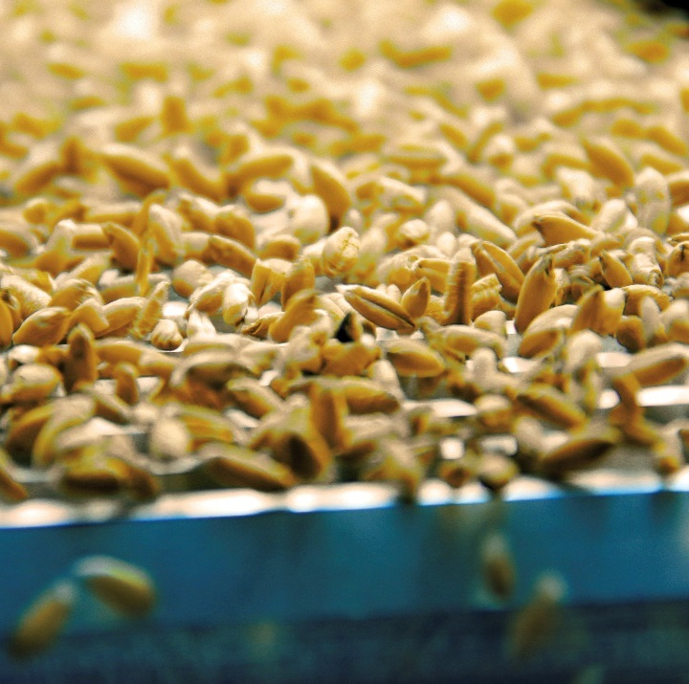
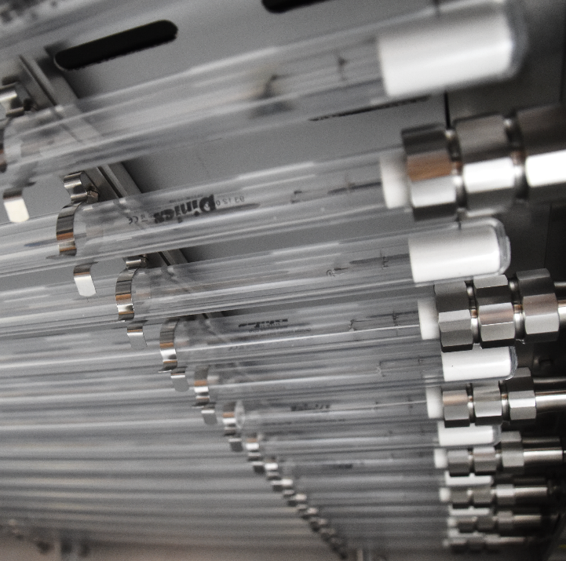
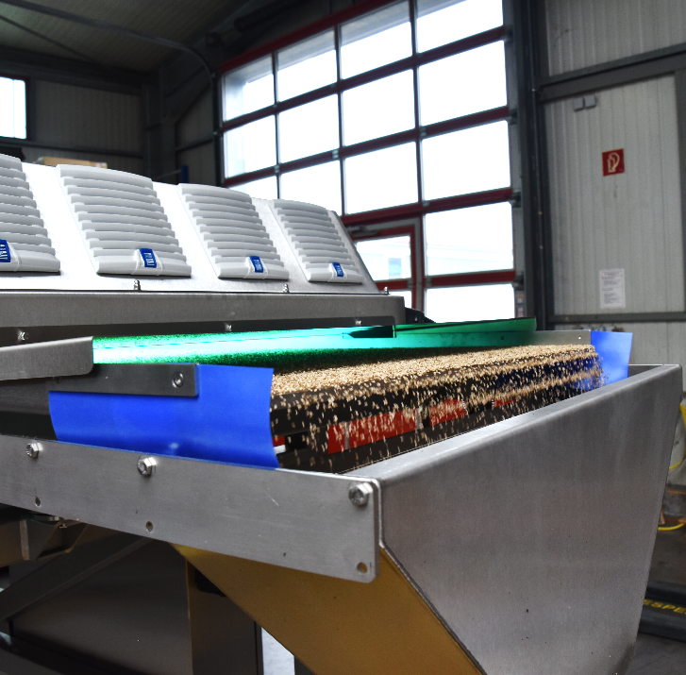
UV-C disinfection process
How does it work?
Due to the vibration the seeds are rotating so they are disinfected 360°
The UV-C lights are disinfecting the seeds
After disinfection the seeds arrive at the end of the transport plate

Slide 18
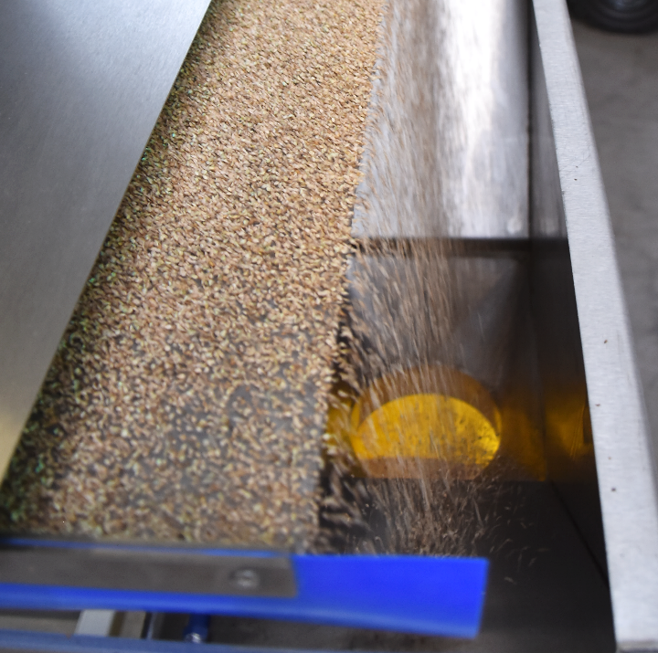
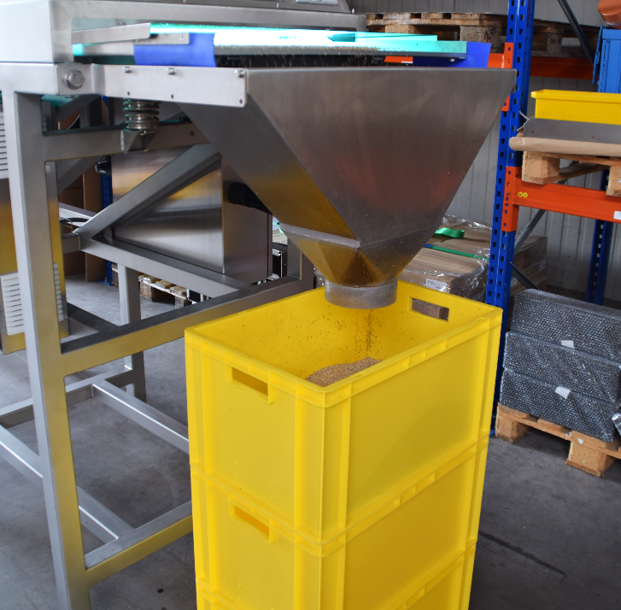
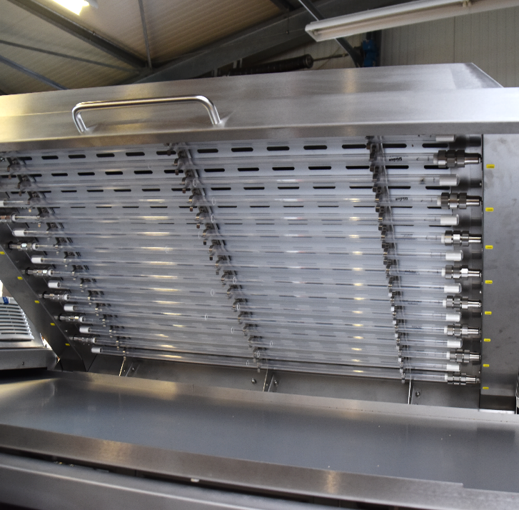
UV-C disinfection process
How does it work?
The seeds are falling into the funnel
Where they can be poured directly into a container or bag
Naiopur can be cleaned very easily when opened

Slide 19
Product specifications

Slide 20
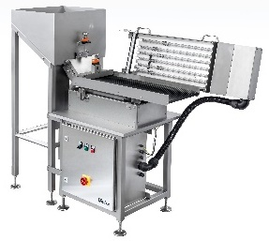
4 different options available
Naiopur, Naiopur Jumbo I, Naiopur Jumbo II & Naiopur Jumbo III
Coming soon
Coming soon
Coming soon
Typ | Naiopur | Naiopur Jumbo I | Naiopur Jumbo II | Naiopur Jumbo III
Rated power | 900W | 2500W | 4900W | 6900W
Lamp power | 540W | 1900W | 3800W | 5700W
Rated voltage | 230V / 50Hz | 380V / 50Hz | 380V / 50Hz | 380V / 50Hz
Number of lamps | 6 x 90W | 16 x 120W | 32 x 120W | 48 x 120W
Dimension L x W x H | 1800 x 600 x 1400mm | 2500 x 900 x 1200mm | 3800 x 900 x 1200mm | 5200 x 900 x 1200mm
Band width | 300mm | 800mm | 800mm | 800mm
Disinfection length | 900mm | 1200mm | 2400mm | 3600mm
Working height | 900mm | 900mm | 900mm | 900mm

Slide 21
Product features
Naiopur UV-C disinfector
Stainless steel
Splinter protection according to HACCP
Suitable to various product sizes
Safety switch that turns off UV-C lamps when opened
High quality transport plate and feed hopper

Slide 22
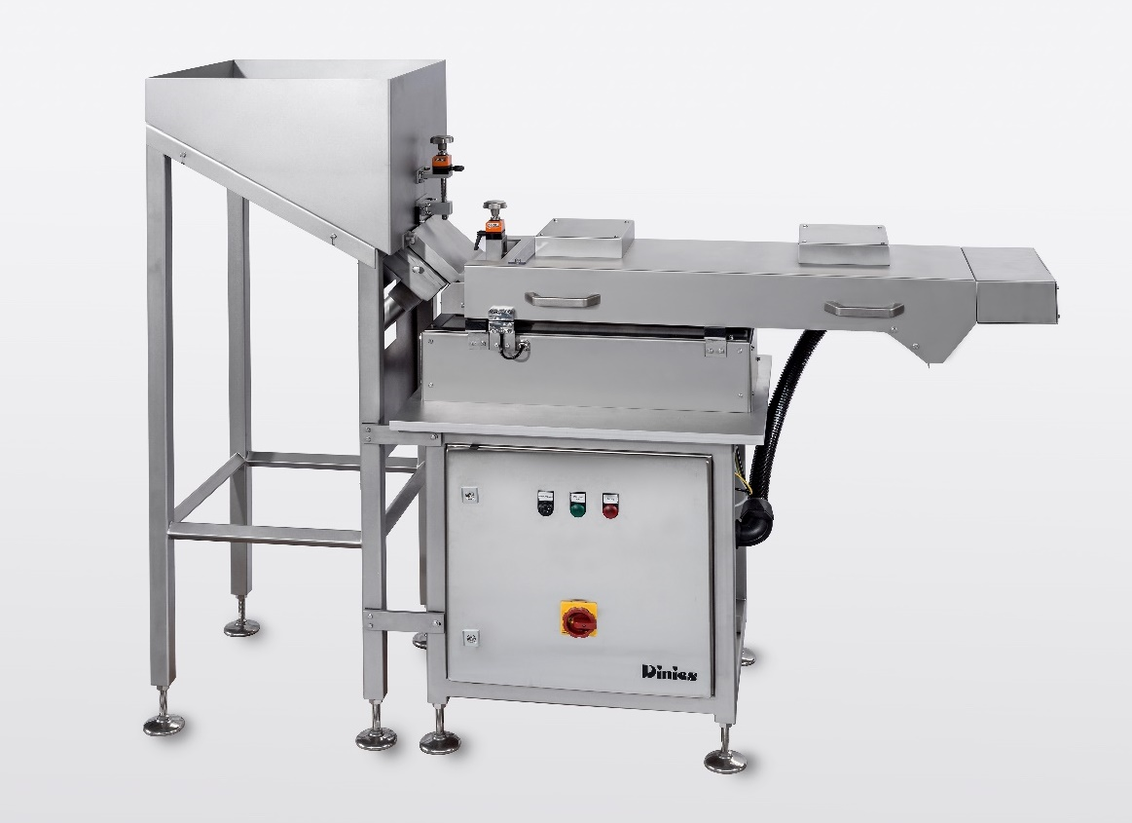
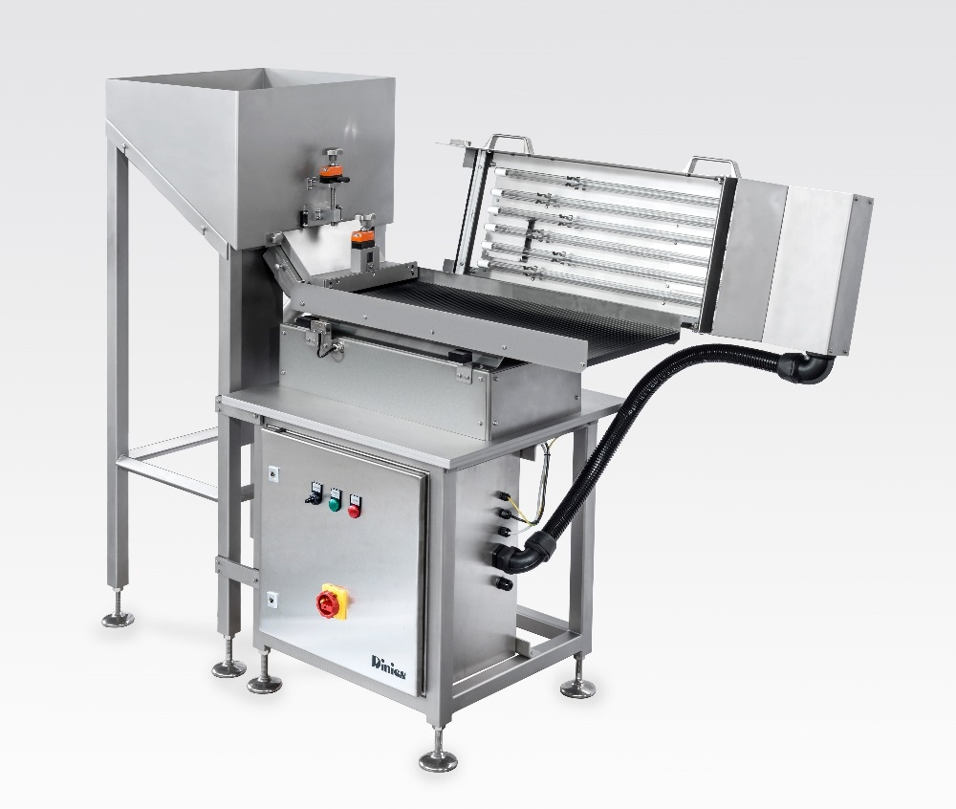
Naiopur
Product pictures

Slide 23
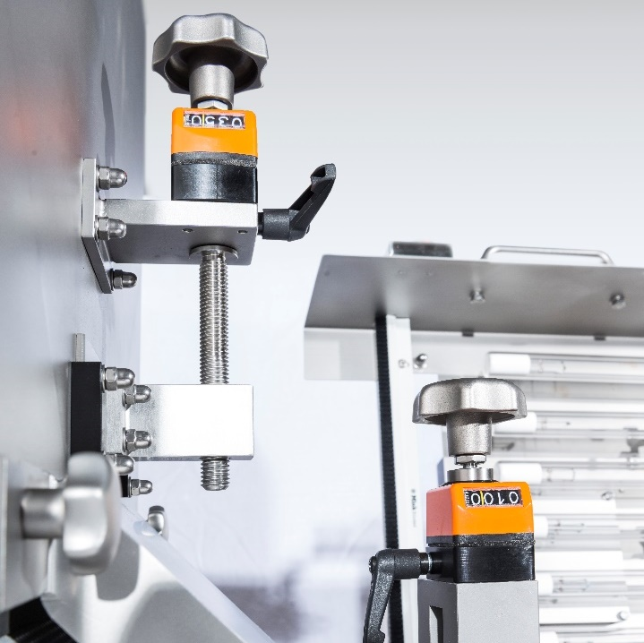
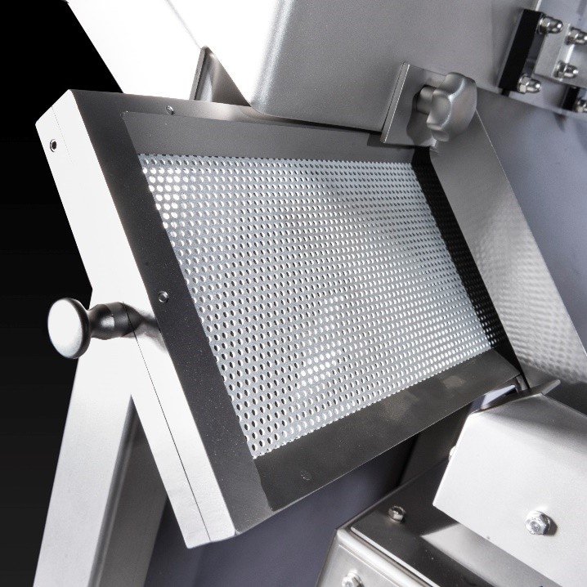
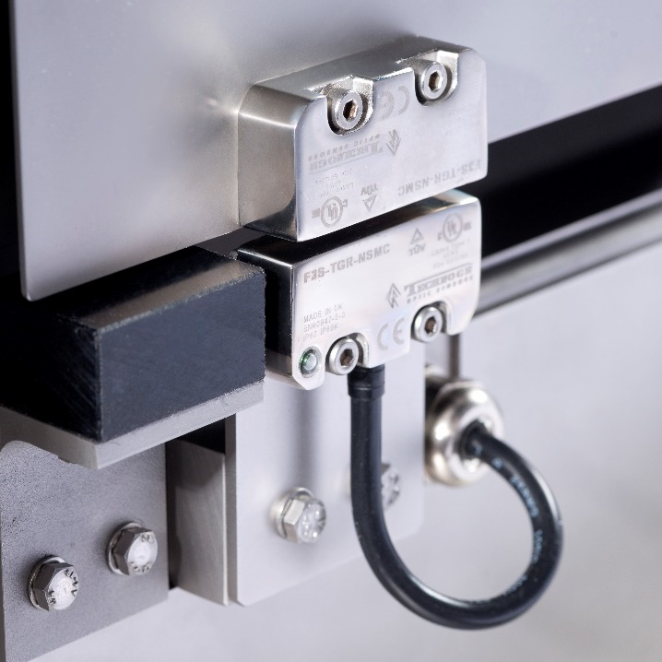
Naiopur
Details
Flow regulator
Replaceable filter
Safety switch

Slide 24
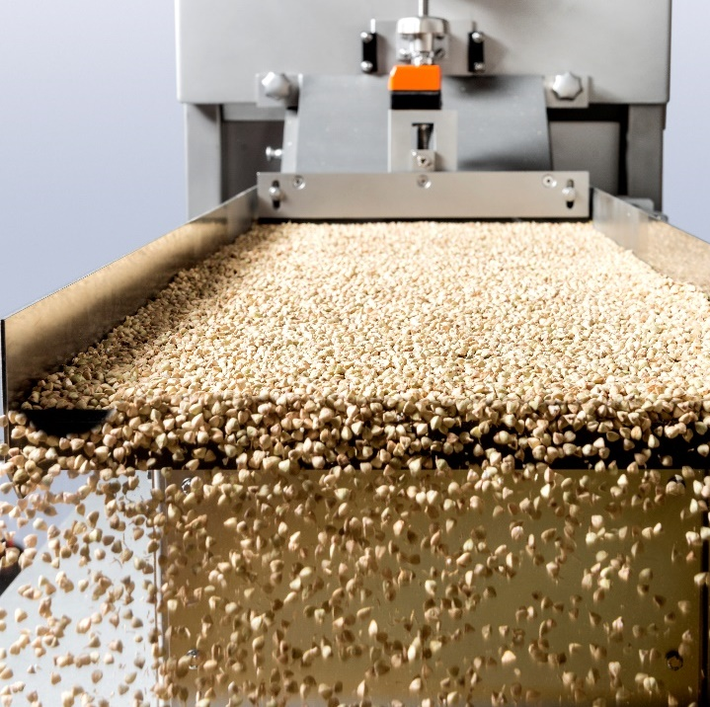
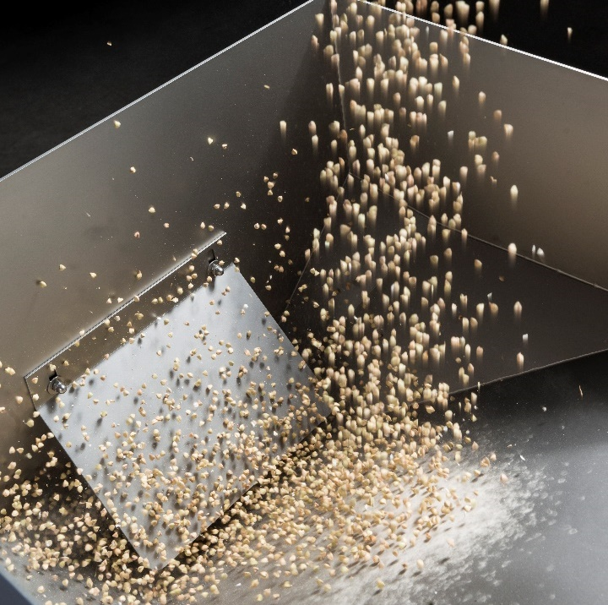
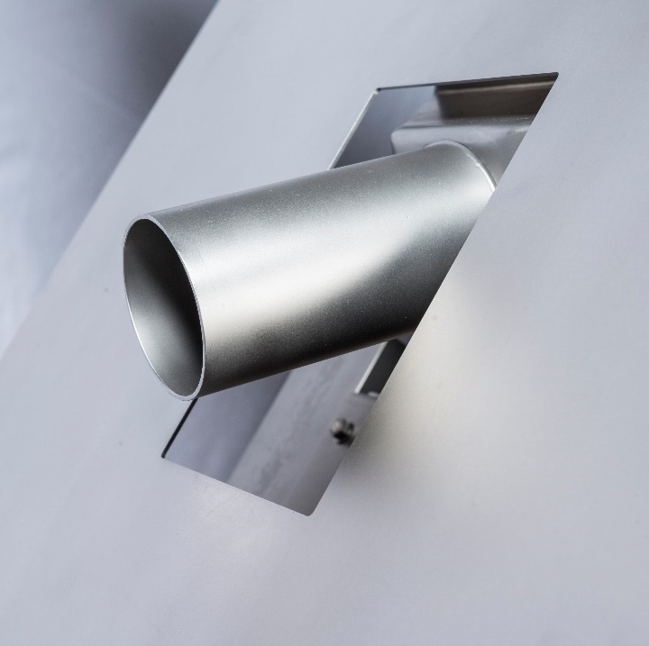
Naiopur
Details
Transport plate
Feed hopper
Dust exhaust host

Slide 25
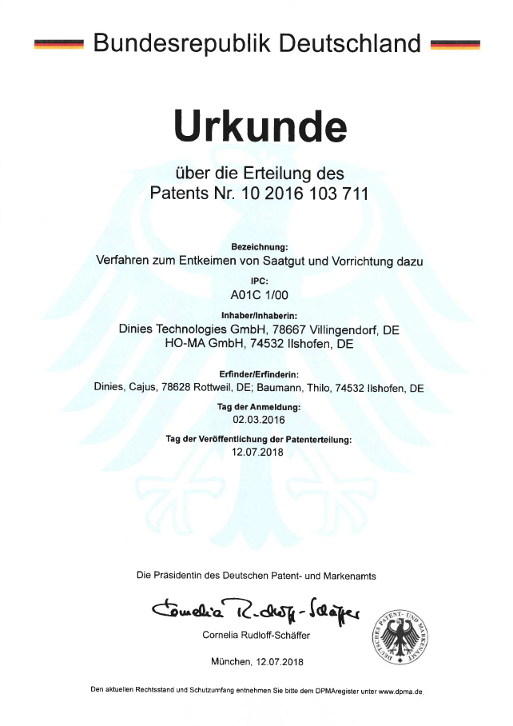
Naiopur
Details
Patented method for disinfecting seeds and a device for it

Slide 26
Naiopur Jumbo
Product pictures
Coming soon

Slide 27
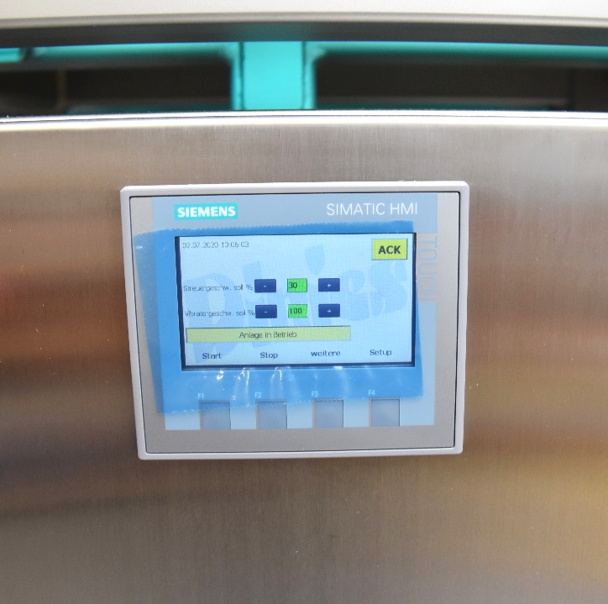
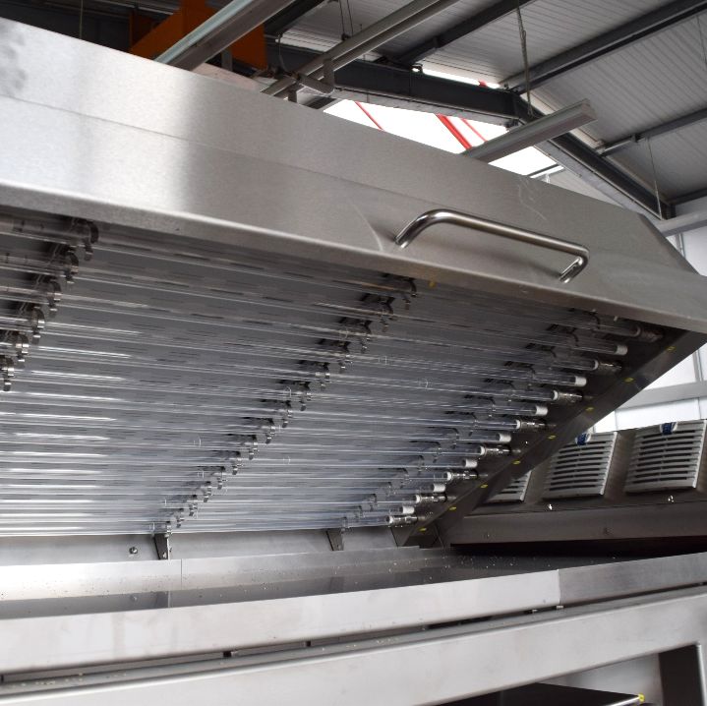
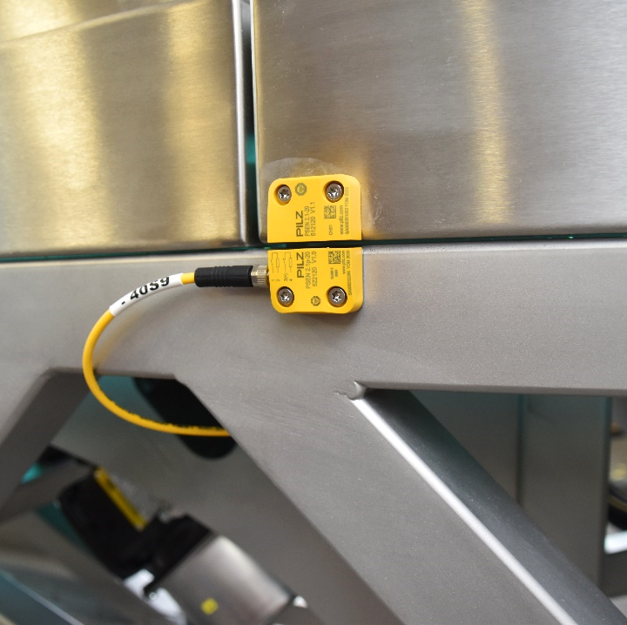
Naiopur Jumbo
Details
Control panel
UV-C lamp power
Safety switch

Slide 28
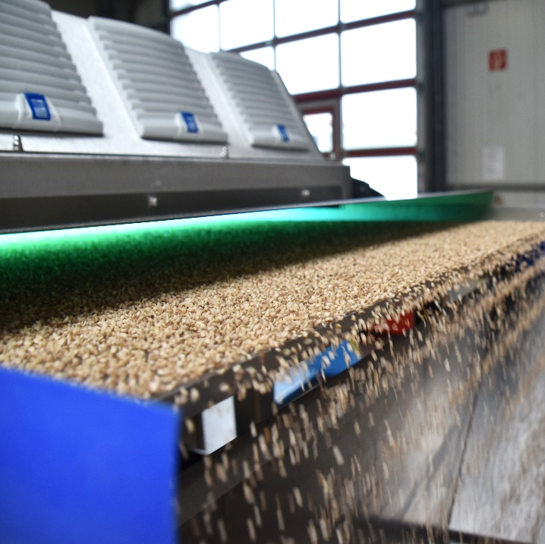
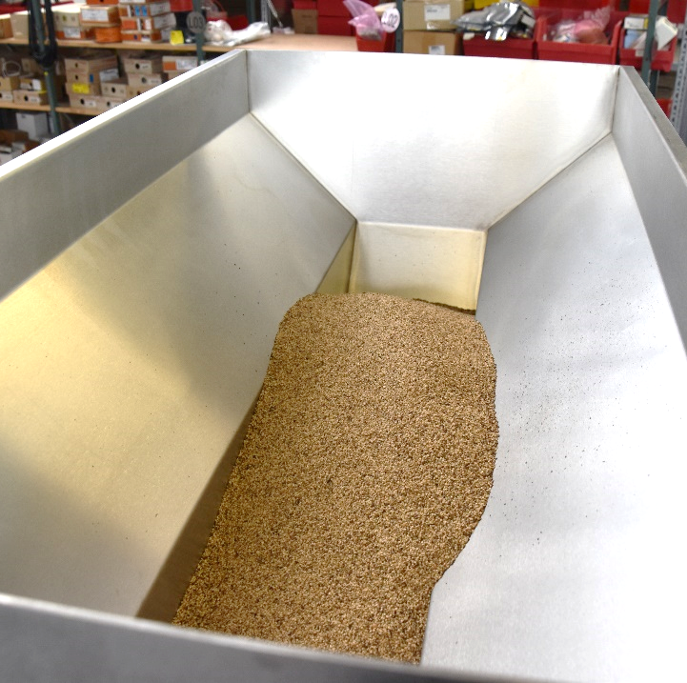
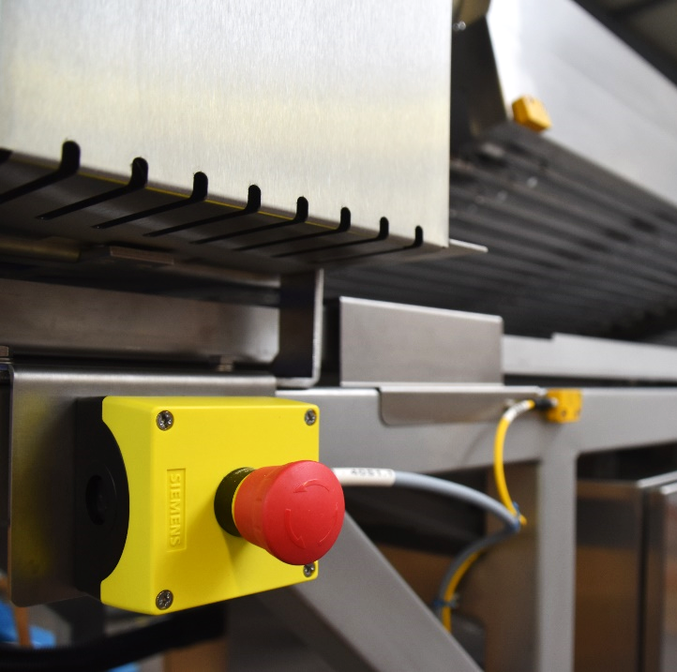
Naiopur Jumbo
Details
Transport plate
Feed hopper with input control
Emergency stop switch

Slide 29
Your advantages
Naiopur UV-C disinfector

Slide 30
Advantages
Naiopur UV-C disinfector
Previously, herbs and seeds were either not disinfected at all or were sterilized with a complicated steam process
NO disinfection with steam → NO lost valuable contents
Disinfection of seeds and grains optimizes your product
Elimination of microorganisms (viruses, bacteria, mold, …)
Improvement of germination capacity
Clean and disinfected product
Longer shelf life of product

Slide 31
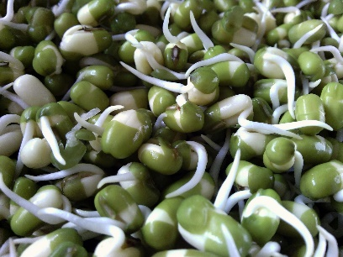
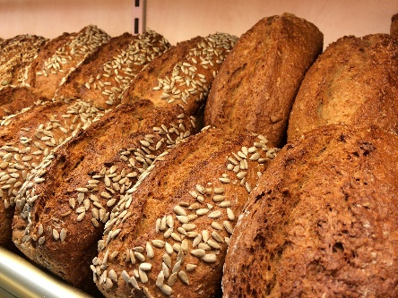
Advantages
UV-C disinfection
Harvest
UV-C Disinfection
For sowing
For selling
Improvement of germination capacity
No introduction of contaminated seeds
Increase of seed quality
Protection for customers
Higher product quality
Increase of storage life

Slide 32
Advantages
For your product
Disinfection up to 99.9%
Increase of storage life
Improvement of germination capacity
No negative influence on product quality
Consistency of product remains unchanged

Slide 33
Advantages
Naiopur UV-C disinfector
100% ecological without the use of chemicals
Safety switch for prevention of burns
Easy handling with high production efficiency
Low operating costs
Low maintenance

