Slide 1
CLEANER SPILL SOLUTIONS
PeatSorb is non-toxic, 100% organic, and renewable. It encapsulates wastes and prevents the spread of hazardous liquids.
www.evergep.com

Slide 2
www.evergep.com
About
Our PEATSORB was formed in 1989 with its roots based in Canada. Canada has 25% of the world’s Sphagnum Peat Moss and the only Peat Moss that through a proprietary process can alter its DNA to absorb its relative the Hydrocarbon. PEATSORB maintains its high regard in its own right by proving its abilities time and time again. We also have joint venture partners when the spill requires cutting edge machinery to offer in our product line. PEATSORB specializes in producing a high performance absorbent remediator that is hydrophobic and now we also have an engineered Water Hydrocarbon Absorbent. All of PEATSORB’s Absorbents are environmentally, friendly solutions for a diverse range of industries that include; Oil & Gas, Energy, Mining and Industrial Manufacturers to name a few.

Slide 3
Environmentally Friendly
Non-toxic
PEATSORB is a highly effective and environmentally friendly absorbent product used for the cleanup of spills.
It is designed to quickly and efficiently absorb all categories of liquid hydrocarbons on contact, encapsulates for landfill disposal. Less used, less to dispose of, less cost, for the most absorbed of even the most complex of hydrocarbons. IDEAL for Liquid Waste Management!
PEATSORB is commonly used in industrial settings where spill control must be managed with minimal risk, therefore it is critical to use PEATSORB. The cleanup time is greatly reduced and so are the on-the-job and environmental hazards.
Furthermore, PEATSORB is non-toxic, non-abrasive, and free from harmful chemicals. It is safe to handle and does not pose any health risks to workers or the environment.
www.evergep.com

Slide 4
Natural &
Sustainable
The key feature of PEATSORB is its natural and sustainable composition, a renewable resource of Canadian origin.
The natural particle size and lightweight form make for excellent absorbent properties. It has a high porosity, allowing it to quickly soak up liquids and retain them within its cellular structure, permitting landfill disposal with its non-leaching characteristics. No secondary contamination can occur.
SAFE FOR ALL MARINE LIFE, ANIMALS, BIRDS, PLANTS, CORAL REEFS, RARE VEGETATION,…ETC, ALL CAN BE PRESERVED ECOLOGICALLY.
www.evergep.com

Slide 5
www.evergep.com
Easy
Cleanup
THE CLEANUP PROCESS USING PEAT SORB
IS STRAIGHTFORWARD.
When a spill occurs, PEATSORB is deployed over the affected area. It immediately begins to absorb the liquid. It can be easily swept or shoveled, broadcast, spread and vacuumed once the spill is contained, leaving behind a clean and dry surface.
Where the spill incident allows, the spent Absorbent can then be placed in a separate container for multiple reuses for the next spill, as it still has wicking power right up until visibly fully saturated and then disposed of.

Slide 6
Natural &
Water Repellent
With respect to oil or petrol spills on water PeatSorb’s ability to float is of great benefit. PeatSorb will float for a considerable amount of time, depending upon prevailing conditions,
During this time, it will soak up water-borne oil on contact. All oil is absorbed and retained within the PeatSorb where it can do no further harm to the environment.
PEATSORB IS A BIODEGRADABLE,
100% NATURAL PRODUCT.
www.evergep.com

Slide 7
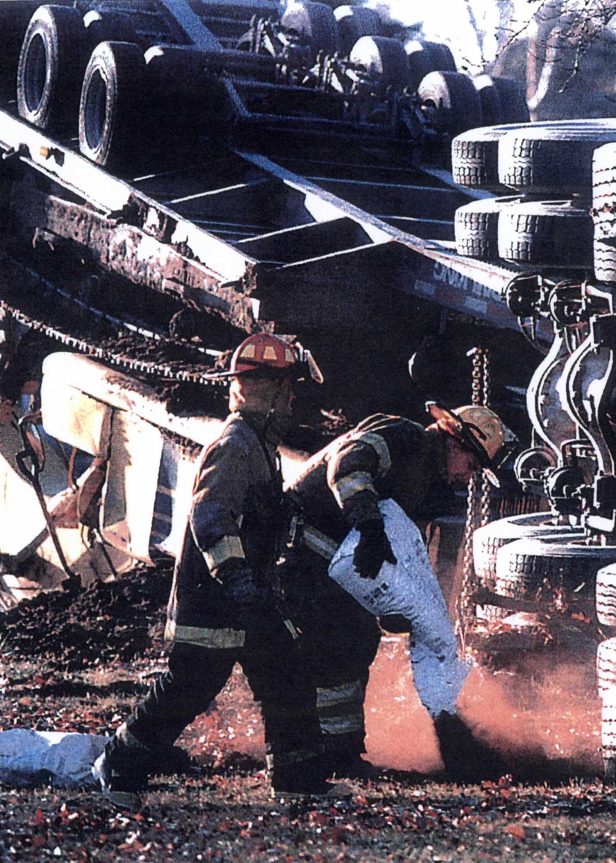
Trusted by
Fire Departments
Effective spill response involves rapid limitation of exposure pathways to prevent skin contact, inhalation or ingestion of volatile chemicals.
THE VAPOUR-SUPPRESSIVE AND STATIC-RESISTANT QUALITIES OF PEATSORB ARE SIGNIFICANT SAFETY FEATURES FOR “SPILL RESPONSE” CREWS.
www.evergep.com

Slide 8
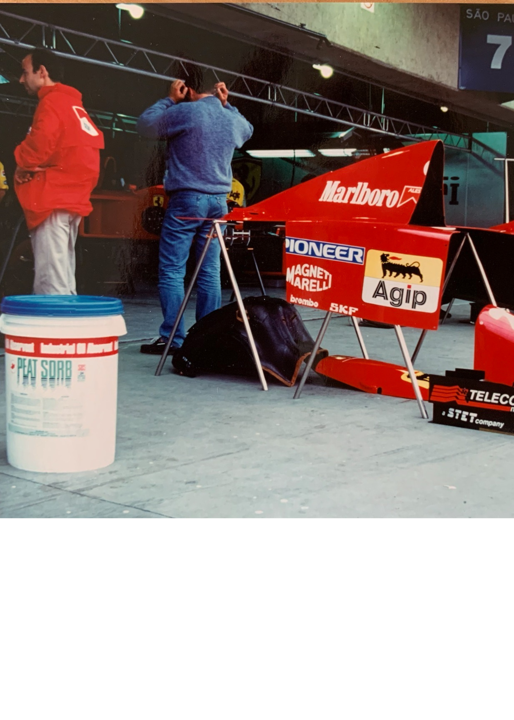
Trusted by
Race Car Drivers
PEATSORB is non-abrasive. For abrasive wear to happen, machinery must come in contact with another substance of equal or greater hardness. PEATSORB, with a hardness of about 1 will not damage steel which has a hardness factor of 5. Clay, the most commonly used inorganic sorbent, has a hardness exceeding 6 and will damage metal parts and cause deterioration of rubber and plastic parts.
PEATSORB CAN BE USED AROUND ALL MACHINERY WITHOUT DAMAGING EXPENSIVE EQUIPMENT.
www.evergep.com

Slide 9
www.evergep.com
TOP 10 ENVIRONMENTAL BENEFITS OF PEATSORB
1. Absorbs on Contact
6. Non-abrasive for machinery
2. Vapor Suppressant
7. Zero health risks
3. Easily Disposed of
8. Lightweight
4. Non-toxic
9. Non-leaching
5. Cost Effective – Re-useable
10. For use on land or water
Note: Always check SDS’s of clay-based products for organ toxicity warnings. PEATSORB has ZERO HEALTH RISKS and does not contain Crystalline Silica, a known cancer-causing agent. Beware of Absorbents that do.

Slide 10
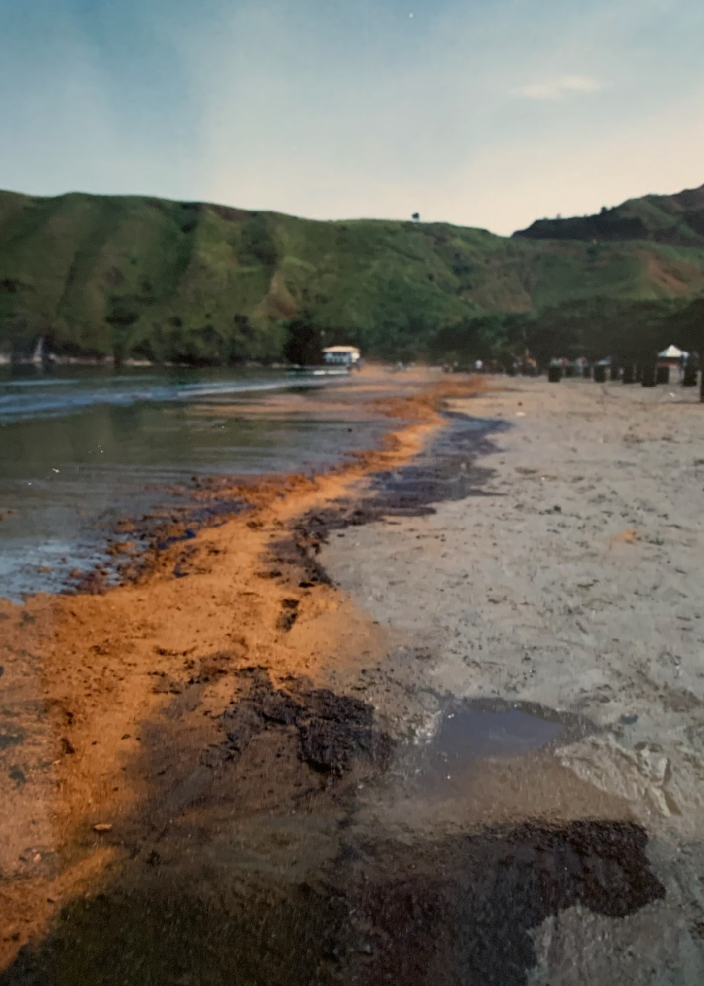
No Spill Too Large...
www.evergep.com
In May of 1994 a Brazilian land oil pipeline ruptured and dumped 2.7 million litres of oil into the environment. Within hours the oil found its way into the Atlantic Ocean and contaminated an exotic local beach, threatening the natural ecosystem and destroying local swimming and tourism. The area was declared an environmental disaster of enormous proportions.
Local authorities attempted mechanical cleanup, although a valiant effort – it proved to be futile. Our PEATSORB’s Distributor demonstrated the efficacy of PEATSORB. It was the obvious choice. Soon tons of PEATSORB was applied to the shoreline. With two applications in just one day, the beach was virtually restored to its former state and after two weeks of sporadic applications to counter new contamination, the beach was opened, safely, to the public once again.
NO OTHER ABSORBENT HAS EVER BEEN SINGULARLY AWARDED AS LARGE A PROJECT AS PEATSORB.
WE CLEANED UP 2.7 MILLION LITRES OF CRUDE OIL AND HAVE THE VIDEO TO PROVE IT!

Slide 11
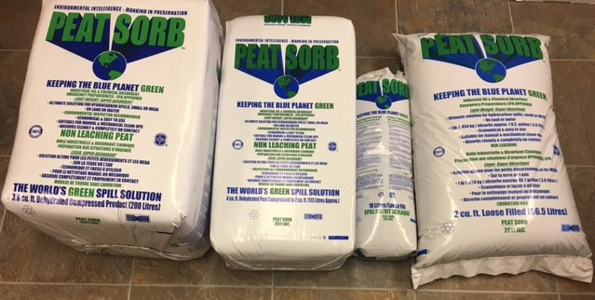
- A Little Goes a Long Way
PEATSORB comes in a variety of sizes for easy handling.
One 30 lb. bale of PEAT SORB will effectively do the same job as 10 bags of clay, resulting in significant SAVINGS IN TIME, LABOUR, REMEDIATION, DISPOSAL AND STORAGE COSTS.
1 x 30lb bag Peat Sorb = 10 x 30lb bags clay
www.evergep.com

Slide 12
Earth Day is Every Day
PEATSORB has practiced and delivered environmental excellence since its inception. Ahead of its time on environment and ecology with “Best Practices” our long history of helping globally to render the spill harmless is our tradition. PEATSORB values the health and safety of its customers, partners, distributors and all marine and land species in the communities that it serves.
Our products neutralize toxicity, suppress flammable vapours and have high biodegradability results to prove below regulatory limits and non- detect readings after treatment. We deliver the highest quality products that outperform our client’s performance objectives.
www.evergep.com

Slide 13
Health, Safety, Environment
PEATSORB maintains its Quality Management to have received many Federal Government approvals
and various accreditations for use anywhere in the USA, Canada and globally.
The Canadian Food Inspection Agency (CFIA) has issued a “Blanket Letter” to all International Customs Inspectors that we are safe for importation with no pathogens present due to the proprietary process it undertakes, meeting all regulations and guidelines.
www.evergep.com

Slide 14
www.evergep.com
Properties
Absorbs on Contact
Effective on Land & Water
Non-Toxic
Non-Leaching
Biodegradable
Lightweight
Non-Abrasive
Vapour Suppressive
Easily Disposed of
Cost Effective

Slide 15
Multi-Functional
In any Climate
Non-Leaching
PeatSorb will work with the full range of oil-based products from crude oil, gasoline, PCB's, coal tars, fatty acids, hydrocarbon-based inks and will solidify and absorb resins
For use on land, in soil, on water, for any indoor or outdoor application, as a “Best Practice” can be used insitu or exsitu with proven, healthier vegetation as the benefactor.
Oil absorbed does not leach out and is naturally degraded. Peat Sorb’s Lab Tests prove a hydrocarbon encapsulated in PeatSorb is safe for Landfill.
www.evergep.com

Slide 16
Need to Absorb
Chemicals & Water?
PeatSorb’s newest technology “WHA” (Water Hydrocarbon Absorbent) solves another problem - absorbing both the water that is contaminated and all the chemicals, as opposed to separating the water from the hydrocarbons, all is solidified.
WHA - DOESN’T LEACH AND THEREFORE IS SAFE FOR LANDFILLS AS A SOLIDIFICATION AGENT IN LIQUID WASTE MANAGEMENT.
www.evergep.com

Slide 17
How does it work?
Water Hydrocarbon Absorbent
www.evergep.com
These contaminants in water are from large tank batteries that are leaking into the soil.
When trying to cause the water and chemicals to release, even under pressure, they don’t, because they are now trapped inside the cellular structure of PeatSorb’s WHA. The paper towel remains clean and dry.
After everything was absorbed, it was also noticed that the soil no longer had an odor.

Slide 18
www.evergep.com
ENCAPSULATION TEST
PeatSorb did not ignite, proving it is vapor suppressing.
www.evergep.com

Slide 19
IS USED BY
www.evergep.com
Airports
Armed Services
Auto Wreckers
Beach Cleanup Crews Boaters
Camp Grounds
Car Manufacturers
Chemical Companies
Car Shows
Construction Sites
Cruise Ships
Dealerships
Elevator Companies
Factories
Farms (Agricultural,
Animal and Fish)
Fire Departments
Food Industry
Gas Stations
Golf Courses
Government
Haz Mat Teams Hospitals
Hotels
Hydro
Machine Shops Marinas
Military
Mines
Morgues
Navy
Oil Refineries
Paint Manufacturers
Parking Lots
Petroleum Industry
Ports and Harbors
Power Plants
Race Tracks
Railroads
Recreational Vehicles Retail Outlets
Service Garages Shipyards
Spill Contractors
Steel Companies
Subways
Tool & Dye Makers
Transit Authorities
Transportation Trucks
Waste Haulers
Wind Turbine Facilities
ENDLESS INDUSTRIES!

Slide 20
ABSORBS THE MOST!
www.evergep.com
Acetone
Acetronitrile
Amvl Acetate
Battery Acid
Benzene
Blood
Butanol
2-Butanone
Bromodichloromethane
Bromoform
Carbon Disulfide
Carbon Tetrachloride
Chloroform
Chloromethane
Chlorobenzene
Crude Oil
Cutting Oils
Cvclohexane
Dichlorobenzene
1, 2-Dichloroethene
Diesel Fuels
Ethanol
Ethylbenzene
Ethyl Ether
Ethylene Glycol Gasoline
Glycerine
Heptane
Hexane Hexachlorobenzene
Hexachlorobutadiene
Hexachloroethane
Hydrochloric Acid
Hydrofloric Acid
Isobutanol
Isopropene
sopropanol
Jet Fuels
Kerosene
Methanol
Methylene Chloride
Methyl Ethyl Ketone
Methylphenol
Isopropanol
Jet Fuels
Kerosene
Methanol
Methylene Chloride
Methyl Ethyl Ketone
Methylphenol
Motor Oils
Muriatic Acid
Napthanlene
2-Nitroaniline
Nitrobenzene
PCB’s Perfluorooctanesulfonic Acid (PFO)
Pentane
Pentachlorphenol
Phenol
Propanol
Styrene
Sulphuric Acid
Teytrachloroethane
Tetrachloroethylene
Propanol
Styrene
Sulphuric Acid
Teytrachloroethane
Tetrachloroethylene
Tetrahydrofuran
Toluene
Trichloroethylene
Trichlorophenol
Trichlorophenoxyacetic Acid (Ingredient in Agent Orange)
Varsol
Vinyl Acetate
Vinyl Chloride/ Xylenes
AND MORE TO BE DISCOVERED !

Slide 21
www.evergep.com
Peat Sorb is approved with:
Canadian Federal Government and with offshore countries for shipping globally.
We are happy to consult with your Operations Management Team, to ensure Workplace Safety and Environmental Guidelines are met with PeatSorb, as a part of your essential requirements.

Slide 22
PEAT SORB MEETS THE CRITERIA FOR THE BIOPREFERRED PROGRAM
What is the USDA, Sept 12th 2023, Executive Order BioPreferred Program? USDA's BioPreferred Program. The goal of BioPreferred is to increase the development, purchase and use of biobased products through two initiatives: procurement preference by Federal Agencies and their contractors, and voluntary product certification and labeling for consumers.The recognition assures a consumer that the product contains a USDA-verified amount of renewable biological ingredients.
What are the benefits of bio based products?
As they are derived from renewable raw materials such as plants, bio-based products can help reduce CO2.
www.evergep.com

Slide 23
Join our growing client list

Slide 24
PEATSORB IS A
GAME CHANGER
RETHINK THE SPILL
About PeatSorb - We will provide the best innovative solutions to our customers combining high performance with ecologically friendly products.
Please contact us to see how we can tailor solutions to meet your specific requirements.
www.evergep.com

